Slide 1
OPTIMIZATION TECHNIQES PRESENTATION
Real life Problem used: QUALITY CONTROL
MINIMIZING DEFECT RATE IN MANUFACTURING
APPLICATION OF GOLDEN-SECTION & STEEPEST DESCENT METHODS

Slide 2
SOURCE OF DATA: https://www.kaggle.com/datasets/rabieelkharoua/predicting-manufacturing-defects-dataset
APPLICATIONS:
In this project, optimization techniques are applied to Quality Control in a manufacturing process. The goal is to minimize the Defect Rate by adjusting process and maintenance parameters such as Maintenance Hours, Production Volume, Additive Process Time, and Quality Score. Two unconstrained optimization methods are implemented in R to determine the best operating conditions that result in the lowest defect rate:
1. Golden Section Search (single-variable optimization)
2. Steepest Descent Method with Exact Line Search (multi-variable optimization).
DATA DESCRIPTION:
The dataset, manufacturing_defect_dataset.csv, contains 17 columns representing production, maintenance, energy, and quality-related parameters.

Slide 3
Column Name | Description |  | Column Name | Description
ProductionVolume | Number of units produced during the production cycle. |  | StockoutRate | Frequency of inventory shortages during the production cycle.
ProductionCost | Total cost incurred for producing the batch of items. |  | WorkerProductivity | Output per worker or per labor hour.
SupplierQuality | Quality rating of supplied raw materials (1–10 scale). |  | SafetyIncidents | Number of safety-related events recorded.
DeliveryDelay | Average delay (hours or days) in delivery of inputs or outputs. |  | EnergyConsumption | Total energy consumed (in kWh) during production.
DefectRate | Percentage of defective products identified after production. |  | EnergyEfficiency | Ratio of production output to energy consumption.
QualityScore | Overall product quality rating based on inspection parameters. |  | AdditiveProcessTime | Time (in minutes or hours) spent on additive manufacturing processes.
MaintenanceHours | Number of hours spent on machine maintenance during production. |  | AdditiveMaterialCost | Cost of additive manufacturing materials per batch.
DowntimePercentage | Percentage of total production time lost due to maintenance or breakdowns. |  | DefectStatus | Indicates whether the product was defective (1) or non-defective (0).
InventoryTurnover | Ratio of cost of goods sold to average inventory.

Slide 4
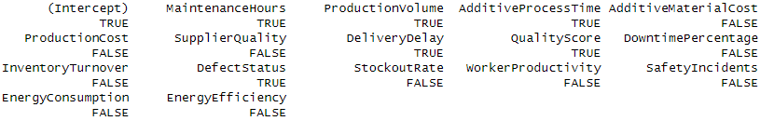
CHOICE OF RESPONSE AND PREDICTORS:
Response variable under study: “Defect Rate”
To choose the predictor variables, we implement the BEST SUBSET SELECTION METHOD
Result from best subset selection:
Among these 6 variables which are selected, “DefectStatus” is qualitative variable so it is not included in this analysis. We only consider the quantitative predictors that can be used in numerical optimization.

Slide 5
Since this is an univariate approach, we take the most important predictor “MaintenanceHours”, and regress “DefectRate” on “MaintanenceHours” to get the objective function.
Here the objective is to minimize the following objective function:
f(x) = a + bx + cx²
Where x is “MaintenanceHours” and f(x) is the corresponding value of DefectRate, and,
a,b,c are coefficients obtained by fitting the regression model.
GOLDEN SECTION METHOD
The Golden Section Search Method is a derivative-free optimization technique used to find the minimum or maximum of a unimodal function within a specified interval.
It uses the golden ratio (≈ 0.618) to divide the interval optimally, evaluating the function at two interior points and eliminating the region that cannot contain the extremum.
The process is repeated iteratively until the interval becomes sufficiently small, ensuring convergence to the optimal solution.
This method is particularly effective for one-dimensional optimization problems.
It is valued for its simplicity, stability, and robustness, though it is slower compared to gradient-based methods.
WHY MAINTENANCE HOURS IS CHOSEN AS THE MOST IMPORTANT PREDICTOR?
On fitting the quadratic regression model for DefectRate on the other predictors, summary of the fitted model shows:
MaintenanceHours has the largest absolute coefficient
strong curvature (significant quadratic term) indicating a clear optimum point

Slide 6
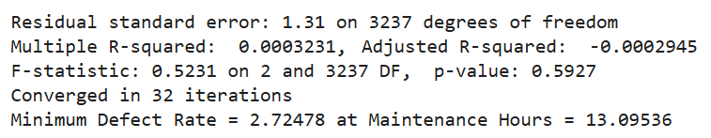
Algorithm Steps:
1. Choose an initial interval [a, b] based on range of x variable.
2. Compute α₁ = a + (1-φ)(b - a) and
α₂ = a + φ(b - a); where φ=0.618 (golden ratio).
3. Evaluate f(α₁) and f(α₂).
4. If f(α₁) ≤ f(α₂), new interval will be [a, α₂], otherwise the new interval will be [α₁,b].
5. Now take this new range and again repeat the aforementioned steps.
6. Repeat the process by narrowing the interval by discarding the subinterval with the higher function value at each step until
|b - a| ≤ tolerance (predefined).
7. Denote the final a and b as a* and b* respectively. The final minimizer is given as (a*+b*)/2
Results obtained:
It converged in 32 iterations.
Optimal maintenance hours = 13.09536
Minimum Defect Rate = 2.72478

Slide 7
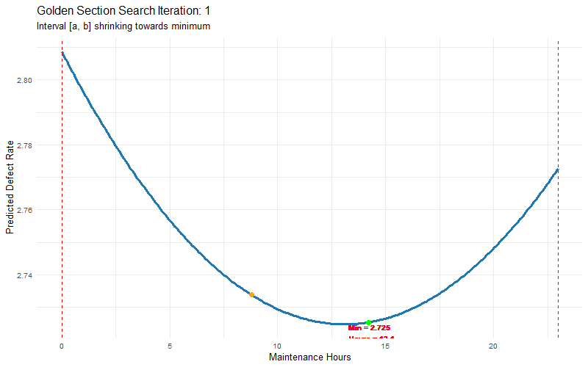
VISUAL REPRESENTATION OF CONVERGENCE THROUGH GOLDEN SECTION METHOD

Slide 8
Algorithm Steps:
Initialize parameter vector x₀ = [x₁, x₂, x₃, x₄].
Compute the gradient ∇f(x₀) of the objective function (Defect Rate).
Set search direction d₀ = -∇f(x₀).
Find the optimal step size α₀ that minimizes f(x₀ + αd₀).
Update parameters: x₁ = x₀ + α₀d₀.
Similarly we calculate all these repeatedly for k steps.
Repeat until convergence criterion is met (|∇f(xₖ)| ≤ tolerance), where the tolerance is predefined.
STEEPEST DESCENT METHOD
The Steepest Descent Method is a gradient-based optimization algorithm used for minimizing differentiable multivariable functions.
It iteratively moves in the direction opposite to the gradient, as this direction represents the steepest decrease in function value.
At each step, the parameters are updated using a suitable step size (learning rate), continuing until the gradient magnitude becomes negligible.
The method performs well for smooth and convex functions, but may converge slowly in cases of ill-conditioning or narrow valleys.
To improve efficiency and stability, line search techniques or adaptive step-size methods are often applied.

Slide 9
WHY WE USE 4 PREDICTORS AND NOT 5?
With 5 predictors, the model includes: 5 linear terms, 5 quadratic terms, 10 cross-product terms that is a total of 21 parameters (excluding the response variable). Although the dataset has 1170 observations, the problem arises due to multicollinearity and numerical instability.
The model is giving unstable and poor results.
When one predictor is removed (using 4 predictors instead of 5), the number of parameters reduces significantly (from 21 to 15). This reduces multicollinearity, makes the model matrix more stable, and improves the numerical behavior of the regression. Therefore, the poor performance with five predictors is not due to insufficient data size but rather due to overparameterization, multicollinearity, and numerical instability in the quadratic model.
We exclude the “Delivery Delay” variable from out predictor set as it has the lowest coefficient while fitting the multiple regression model of DefectRate on the 5 predictors.

Slide 10
OBJECTIVE FUNCTION
f(x₁, x₂, x₃, x₄) = β₀ + β₁x₁ + β₂x₂ + β₃x₃ + β₄x₄ + β₁₁x₁² + β₂₂x₂² + β₃₃x₃² + β₄₄x₄² + β₁₂x₁x₂ + β₁₃x₁x₃ + β₁₄x₁x₄
+ β₂₃x₂x₃ + β₂₄x₂x₄ + β₃₄x₃x₄
Here, x₁, x₂, x₃, x₄ denotes the respective values of MaintenanceHours, ProductionVolume, AdditiveProcessTime, QualityScore.
f(x₁, x₂, x₃, x₄) denotes the corresponding value of DefectRate.
Meaning of each coefficients are as follows:
Term | Corresponds to R model term | Meaning
β₀ | (Intercept) | Constant term
β₁, β₂, β₃, β₄ | MaintenanceHours, ProductionVolume, AdditiveProcessTime, QualityScore | Linear effects
β₁₁, β₂₂, β₃₃, β₄₄ | I(MaintenanceHours^2) etc. | Quadratic effects (curvature)
β₁₂, β₁₃, β₁₄, β₂₃, β₂₄, β₃₄ | I(MaintenanceHours * ProductionVolume) etc. | Interaction effects

Slide 11
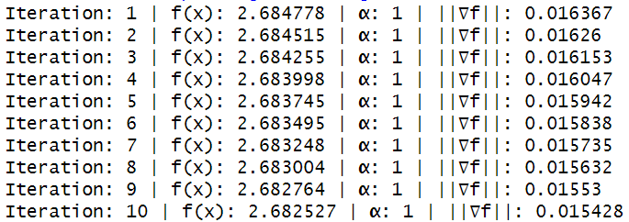
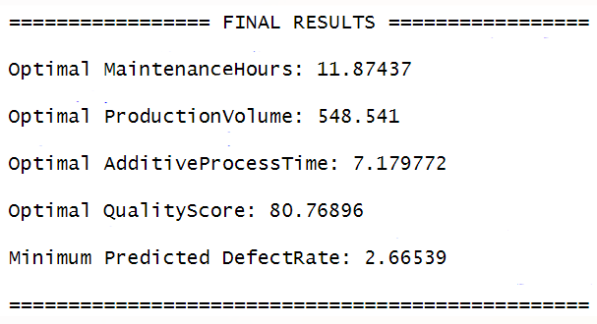
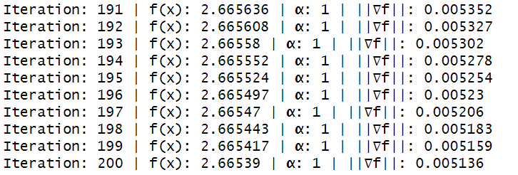
APPLYING IN-BUILT FUNCTION (CONVERGED IN 200 ITERATIONS)
:

Slide 12
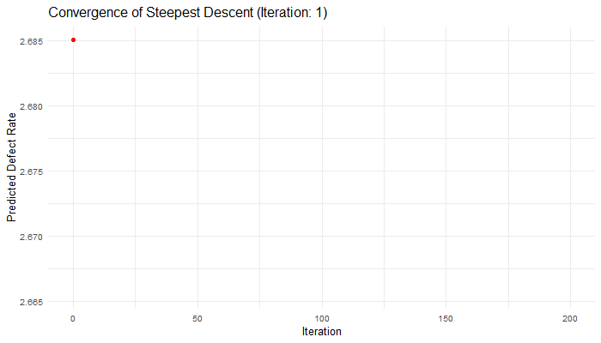
VISUAL REPRESENTATION OF CONVERGENCE THROUGH STEEPEST DESCENT METHOD

Slide 13
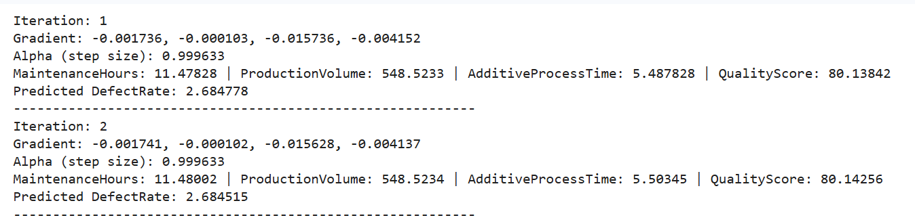
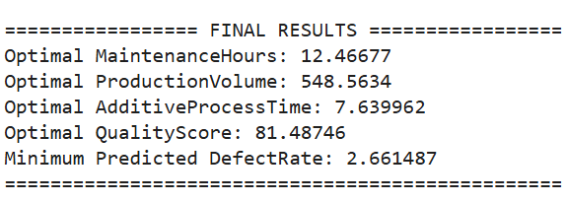
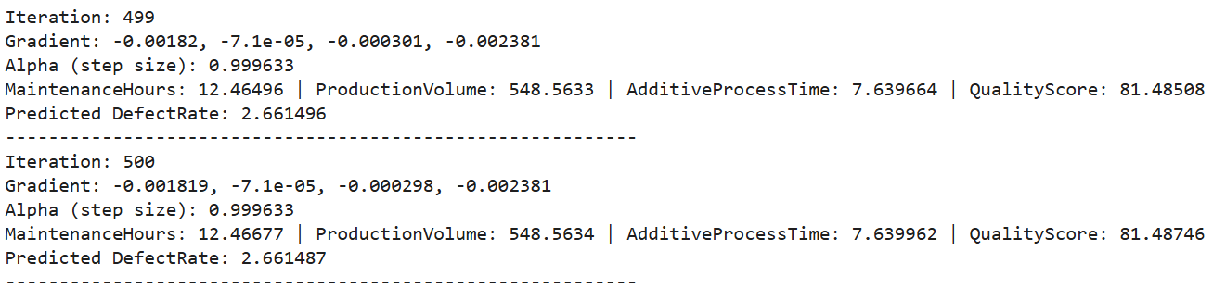
APPLYING USER DEFINED TECHNIQUE
Here, in each step, we calculate the step length using the Golden-Section method.
Thus we incorporate golden-section method into the steepest descent optimization technique and try to find out the optimum values of the predictors, and hence the value of DefectRate.
RESULTS OBTAINED (TOTAL 500 ITERATIONS)
:

Slide 14
COMPARISON OF METHODS
Method | Type | Requires Gradient? | Convergence Speed | Accuracy
Golden Section Search | Direct Search | No | Fast | High
Steepest Descent | Iterative (Gradient-based) | Yes | Moderate | High
Both methods yielded nearly identical DefectRate minima (≈ 2.66–2.72). The Golden Section Search converged faster but applies only to a single variable, while the Steepest Descent Method allowed a multi-variable approach for realistic modeling.

Slide 15
CONCLUSION
This project aimed to minimize the manufacturing Defect Rate using a Steepest Descent Optimization method with Exact Line Search via the Golden Section Search.
A quadratic regression model was developed to express the defect rate as a function of Maintenance Hours, Production Volume, Additive Process Time, and Quality Score. The optimization efficiently converged to a minimum, revealing that Maintenance Hours had the strongest influence on defect rate due to its direct impact on machine reliability and production quality.
The results highlight that combining statistical modeling with numerical optimization provides a powerful approach for data-driven process improvement and quality control.

Slide 16
KEY TAKEAWAYS
A quadratic regression model effectively captured the complex relationships among process variables.
The steepest descent algorithm provided a systematic approach to reach the minimum defect rate.
Exact line search via Golden Section Search ensured precise step size selection and smooth convergence.
Maintenance Hours was found to have the highest sensitivity and influence on defect rate minimization.
The final optimized parameter values offer actionable insights for reducing defects and improving manufacturing efficiency.

Slide 17
FUTURE SCOPE
Incorporation of Constraints:
The current study used unconstrained optimization. Future work can include realistic operational limits such as resource availability, machine capacity, or safety thresholds using constrained optimization techniques (e.g., Lagrange multipliers or quadratic programming).
Extension to Other Optimization Algorithms:
The performance of the Steepest Descent Method can be compared with more advanced algorithms like Newton’s Method, Conjugate Gradient, etc.
Integration with Real-Time Data:
Future implementations can integrate live production data from IoT-enabled systems, allowing real-time defect prediction and dynamic optimization of process parameters.
Development of a Decision Support System:
The optimization model can be built into an interactive software tool or dashboard that helps production managers automatically suggest optimal parameter settings.
Validation through Experimental Studies:
The optimized parameters can be tested on actual production lines to validate the model predictions and assess real-world improvements in defect rates.

Slide 18
THANK YOU

